Slide 1

Web APPLICATION Development (111834)
Dr. Owais Hussain

Slide 2

Agenda
Security
Validation
Authentication/Authorization
Encryption
Content Security Policy
Cross Site Security
Error Handling
Database Security
Ethics

Slide 3
Sample 2
Security
The term security is broad. There are several stages involved.
Physical security deals with the security related to restricting unauthorized access to physical computers running services.
In data centers, hardly anyone accessing the servers’ services is ever allowed to enter the room.
Network security generally involves security in Data link layer, Network layer, and Transport layer (OSI model) using a wide range of tools like Firewall, and routers.
Notes:
OSI: Open systems interconnection

Slide 4
Sample 2
Validation
The front-end application is usually the most vulnerable part. However, it involves risking only one device or a small subset of information.
Front-end security can be improved via following methods:
Validation: making sure that the input is validated before a web server request is made. This generally involves checking mandatory data, allowed range of values, etc.
Validations are the first line of defense against scripting attacks like SQL injections.
Django provides Form Validators to validate input data coming from templates.
Django models also provides various options to validate the input, some examples were discussed in previous lectures.

Slide 5
Sample 2
Authentication and Authorization
Authentication makes sure that the user has access to the application. There is a basic Username/Password authentication process and improved ways:
2-FA: Two factor authentication involves using another party to authenticate, for example receiving a security code via Email/SMS, or using Google/Microsoft Authenticator app.
Open Auth (OAuth): is token-based authentication using 3rd party apps which use personal information like Address and Date of Birth to allow access without revealing password. This is widely adopted by Github, Facebook, and Google. Django provides “django-oauth-toolkit” to implement Open Auth.
Authorization comes into action once a user is authenticated. Here, we make sure that the user only accesses the allowed operations. Front-end authentication is not
Notes:
OAuth 2.0 is the current version. You can notice an option like “Login with Google”. This uses OAuth.

Slide 6
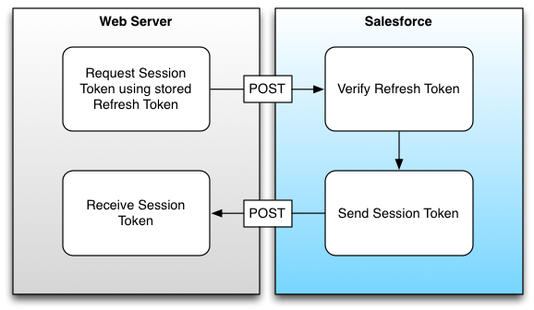
Sample 2
Authentication and Authorization
This is an example of how Salesforce handles OAuth request.
The web server stores a valid authentication toke, or asks for a new token.
Each time the app requires authentication, this token is sent to Salesforece’s own server.
On successful authentication, Salesforce returns a Token which is valid till the Session is open.

Slide 7
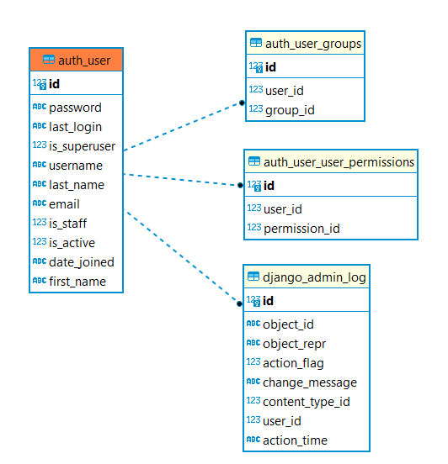
Sample 2
Authentication and Authorization
Authorization comes into action once a user is authenticated. Here, we make sure that the user only accesses the allowed operations.
Implementing Authorization on the front-end alone is not sufficient. There should always be a double check in the server end for authorized operations.
Django’s auth app provides a 3 decorations to enable authorization:
@login_required: requires login before calling a function
@permission_required(permission): ensures that the logged in user has the given permission (like “delete vehicle”) before calling a function
@user_passes_test(test_function): first calls the given function to make sure that a certain criteria is met before calling a function.
Notes:
Give examples of each decoration.
Demonstrate the Django’s Auth configuration using Administration.

Slide 8
Sample 2
Encryption
Encryption: this is to ensure that all the data transfer is encrypted. Therefore, even if someone is eavesdropping, they cannot read the content.
Fun fact: A great many nations are collecting encrypted data in abundance from the internet. Do you know why?
The most common method is to use HTTPS by encrypting all Requests and Responses using a pair of public and private keys.
However, it is sometimes critical to have encryption on top of HTTPS. For example, sensitive Cookie data should be kept in encrypted manner, and should be decrypted on demand.
Notes:
Encryption has been covered in web server lecture in detail
Nations are collecting data so that one day when Quantum computers are powerful enough, they can decrypt this data.

Slide 9
Sample 2
Content Security Policy
Content Security Policy: this policy limits the type of data which can be accepted and loaded in the browser. It is not always advisable to allow all content types. For example, enable multi-part content only when uploading or downloading a file.
It is highly advisable to NOT rely on default CSP, irrespective of which framework you’re building on. This is because by default, almost everything is usually enabled.

Slide 10
Sample 2
Content Security Policy
Implementing CSP in Django can be done in two ways.
Defining a CSP header to allow only the default sources for all styles, scripts and images: Content-Security-Policy: default-src 'self’; style-src: 'self’ bootstrapcdn.com; script 'self' *.cloudflare.com; img-src 'self' imgur.com flickr.com dropbox.com;
Using CSP middleware by installing “django-csp” and adding “csp.middleware.CSPMiddleware” to MIDDLEWARE in settings.py
Additionally, you’ll need to configure policy variables in settings.py. See next slide.

Slide 11
Sample 2
Content Security Policy
# default source as self
CSP_DEFAULT_SRC = ("'self'", )
# style from our domain and bootstrapcdn
CSP_STYLE_SRC = ("'self'”, "stackpath.bootstrapcdn.com")
# scripts from our domain and other domains
CSP_SCRIPT_SRC = ("'self'”, "ajax.cloudflare.com", "static.cloudflareinsights.com", "www.google-analytics.com", "ssl.google-analytics.com", "cdn.ampproject.org", "www.googletagservices.com", "pagead2.googlesyndication.com")
# images from our domain and other domains
CSP_IMG_SRC = ("'self'", "www.google-analytics.com", "raw.githubusercontent.com", "googleads.g.doubleclick.net")

Slide 12
Sample 2
Cross Site Security
Cross-Site Reference Forgery: implement measures to prevent CSRF attacks by using anti-CSRF tokens in forms and verifying the origin of the requests.
Cross Site Scripting (XSS): this is similar to SQL injection, but for scripts. For example, if a user enters “<script>alert('hello')</script>” in a name field, the given script will execute when {{name}} is called. In Django, you can disable escape characters simply by using {{name|safe}} instead of {{name}}. Another way is to use escape blocks. On next slide

Slide 13
Sample 2
Cross Site Security
Hello {{ name }}
{% autoescape off %}
This will not be auto-escaped: {{ data }}.
Nor this: {{ other_data }}
{% autoescape on %}
Auto-escaping applies again: {{ name }}
{% endautoescape %}
{% endautoescape %}

Slide 14
Sample 2
Error Handling
It is dangerous to show the debug trace on the browser, as it reveals all internal operation, structure of views, models, and libraries used. An attacker can take advantage of this information.
Whenever deploying Django in production, always keep DEBUG=False.
The other strategy is to Never pass the actual Error or Exception thrown by the back-end classes. Instead, make use of general HTTP Error codes.
This is not recommended: Error: unable to parse default_user_settings.json
This is a good alternative: Error: I/O operation failed. Error code: 1455
The user can tell the support team the error code 1455 and only the developers will know what it actually means.

Slide 15
Sample 2
Database Security
Your Database is the only thing you are trying to secure. If the database itself is at risk, all other measures mean nothing.
NEVER expose a production database over public channels. This is the main reason we have Data and Service layers in place.
Database should be hosted on an Encrypted OS, preferably separate from the web server machine.
Database backups should be regular, encrypted and kept in a DR (Disaster Recover) site.
Root or Super user account must never be used to serve the application.
Developers and Q/A teams should not have access to the production Database.
Follow Least Privilege Principle.
Deploy a Database monitoring tool with Red flag detection and policy on slow queries.

Slide 16
Sample 2
Ethics
Ethical Computing is among the most neglected topics in Computer Science education today.
Ethics aren’t nice-to-haves, but are strictly tied to moral, legal and social obligations.
We will discuss 6 major areas:
Privacy and Consent
User Education
Social Responsibility
SWOT and PESTLE analysis
Piracy
AI Literacy

Slide 17
Sample 2
Ethics – Privacy and Consent
Privacy is making sure that the User data is not only Secure, but also private. For example, Instagram would not allow its staff to investigate pictures of any user, who has made the content private. Similarly, Apple engineers themselves are disallowed to decrypt an iPhone even if asked by the Govt. agencies.
User’s Privacy involves:
Personal identification details like: Address, contact numbers, biometric information
Government issued details: National ID, Driving license number, Passport information
Financial details: Bank account/IBAN numbers, Debit/credit card number, financial statements
Geographics details: GPS location, Geo history, Places visited or planned, travel history
Social details: people connected to, blocked, relationships, social circles and clubs
Users should be allowed to download all their private data, and permanently delete from the app’s database.

Slide 18
Sample 2
Ethics – Privacy and Consent
Consent: the permission provided by the Users to use their data.
As an application developer, it is your responsibility to obtain permission:
What private data/fields you want to access?
What information is stored permanently, and what temporarily?
Who will have access to certain private data, and for how long?
Will the data be shared with other parties?
User’s consent should be modifiable through User’s preference. For reference, check out Facebook’s Privacy settings.
Consent is not limited to Users. Using a 3rd party library, a CSS/JS copied from Github, an Image downloaded from Instagram, all require permission/attribution.
It is therefore important to look at the License details whenever using a resource.
Notes:
REMEMBER! Consent is a Legal requirement in many countries.

Slide 19
Sample 2
Ethics – User Education
Security Awareness Training: cover topics such as phishing attacks risks, safe browsing habits, and identifying and reporting security breaches.
Password Practices: educate on creating strong passwords. Encourage using password managers to generate complex passwords instead of remembering them.
Phishing Awareness: teach users to recognize phishing attacks like suspicious emails, messages, or websites which trick the users into leak out sensitive information. Explain the common attack tactics like Social engineering (impersonation, pretexting, baiting, or manipulation).
Mobile Device Security: educate users about biometric authentication, installing updates regularly, avoid apps from unofficial sources, keep away from public Wi-Fi networks, and use of VPNs when accessing sensitive information.

Slide 20
Sample 2
Ethics – User Education
Reporting Procedures: communicate the process for reporting security breaches and suspicious activities to the developers. Always leave a feedback section in your apps for this.
Announce Incidents: in case of a data breach, or operation disruption, make public announcement on the extent of damage, the cause, and steps taken for recovery and new measures placed to avoid future mishaps.
Policy Awareness: ensure users know security policies, data protection regulations, and industry compliance requirements.
Continuous Training: security education is ongoing process. Regularly review and update training materials as the industry evolves. This applies not only to users, but also internal staff and development teams.

Slide 21
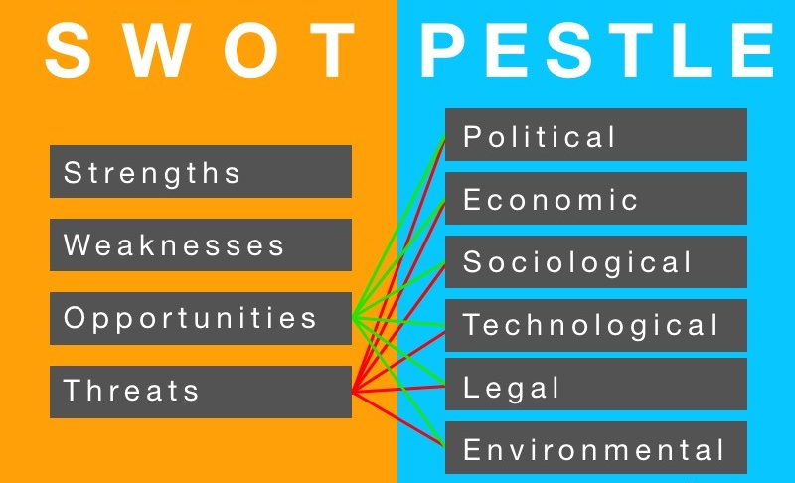
Sample 2
Ethics – SWOT and PESTLE Analysis
The Business analysis primarily focuses on SWOT, thus often ignoring PESTLE analysis.
PESTLE analysis makes sure that as responsible creators, we ensure that our produce either improves, or at least does not cause harm.
If a negative impact is unavoidable, The Corporate Social Responsibility programs ensure that there is ample compensation to the damages.
Notes:
CSR is no favour to the society. It is a responsibility.

Slide 22
Sample 2
Ethics – Piracy
Piracy is a crime of intellectual property theft. It has various forms:
Counterfeiting: creating unauthorized copies of software, fully or paritally.
End-User Piracy: using unlicensed software, whether they were cracked via keygens or by using an authentic key which was not legally obtained.
Internet Piracy: distributing of software online via websites, peer-to-peer channels like Torrents, or file-sharing without the software owner's consent.
Piracy in Education: using unlicensed software in educational institutions. Sometimes a license is freely available for education purpose, but still using it without the license is piracy.
Open-source: compiling open-source code and using without license is also piracy.

Slide 23
Sample 2
Ethics – Piracy
So, what to do instead?
First option is to purchase the license if possible.
Second option is to look for free programs, extended trials, or even directly communicating to vendor for a free or greatly discounted license.
Third option is to find free-to-use alternatives.
Fourth option is to build yourself using available libraries and APIs.
When building an app, make sure that you are not breaching the license agreement.
Notes:
Open source not always means free.

Slide 24
Sample 2
Ethics – Piracy
Best practices:
When using a 3rd party library, use open-source with free licenses like GPL (Gnu Public License), MIT (MIT University), MPL (Mozilla Public License), etc.
If downloading a resource from internet, use Public domain and free to share resources.
Excerpts of someone else’s code requires citing the author in comments.
When referring to an article, magazine, or research paper, include citation.
For large-scale projects ask for Legal council and conduct Software Audit.
Notes:
Open source not always means free.

Slide 25
Sample 2
Activity 4
Record a 15-minute video presentation on compliance. You can choose any of the topics below:
Salient features of GDPR compliance
Importance of HIPAA compliance in healthcare
ISO/IEC 27701 privacy compliance

Slide 26



THANK YOU
Owais Hussain
+92 345-3174270
owais.hussain@kiet.edu.pk
https://www.researchgate.net/profile/Owais-Hussain-3

